Slide 1
welcome
Presentation on horizontal bar format

Slide 2
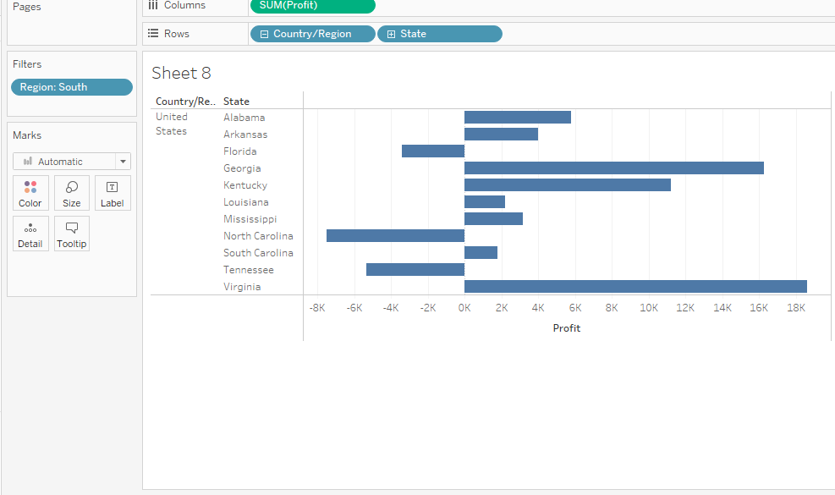
2.Represent the profit map in horizontal bar format

Slide 3
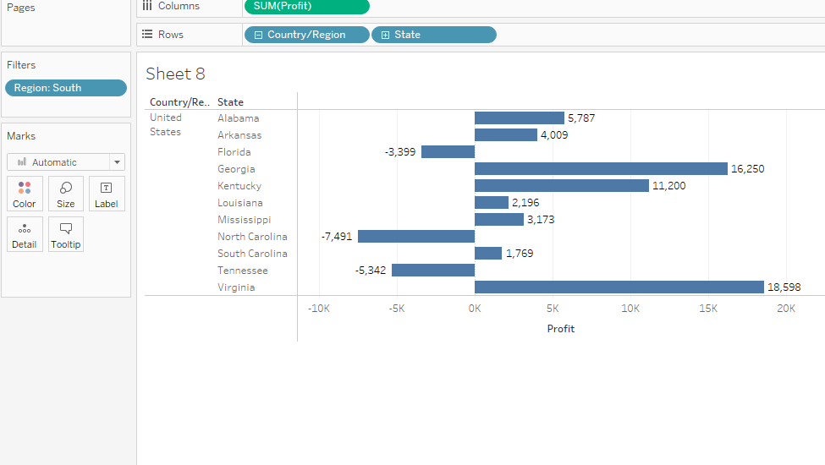
3.Show only the states having negative profit in bar graph

Slide 4
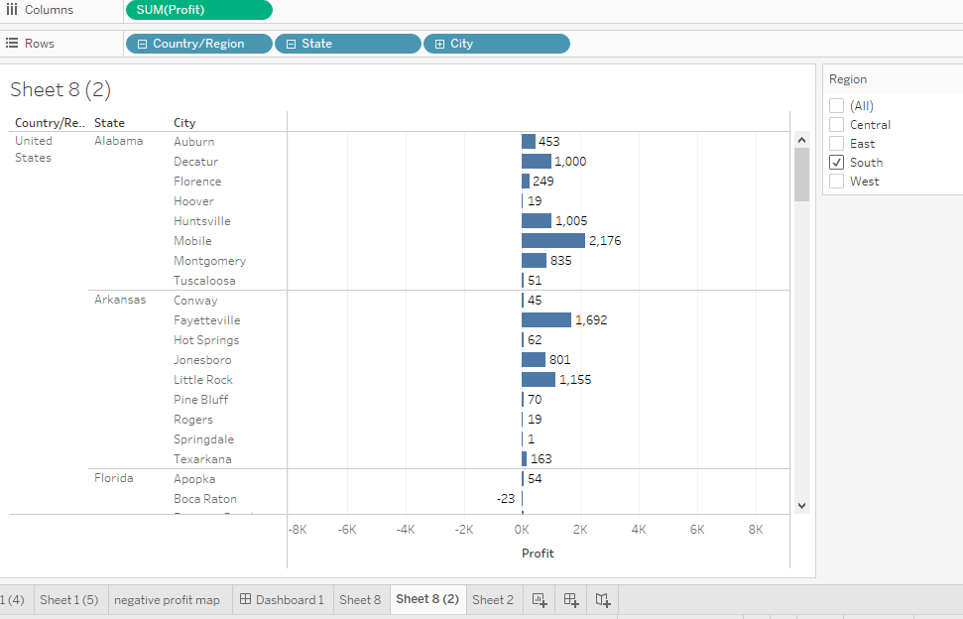
4.On the rows shelf,click the plus icon on the states field to drilldown to the city level of detail

Slide 5
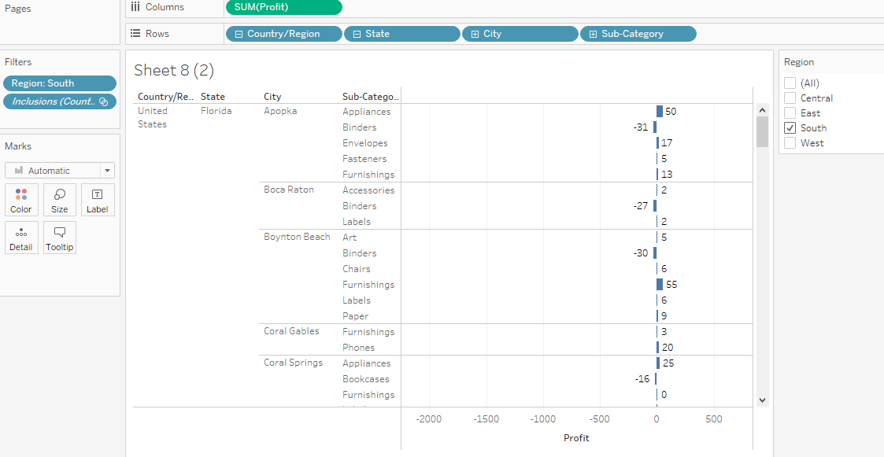
5.Show the profit subcategory wise for all the states and city having negative profit

Slide 6
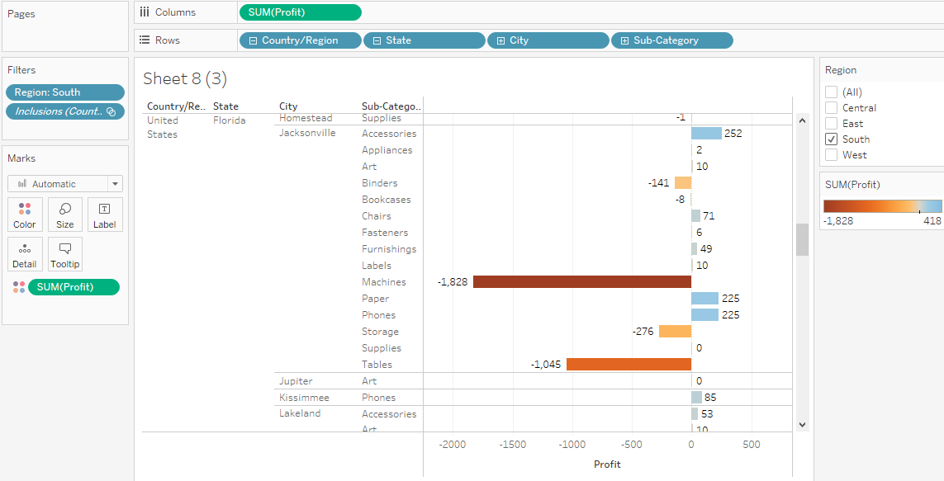
8.Show the profit in different colour

Slide 7
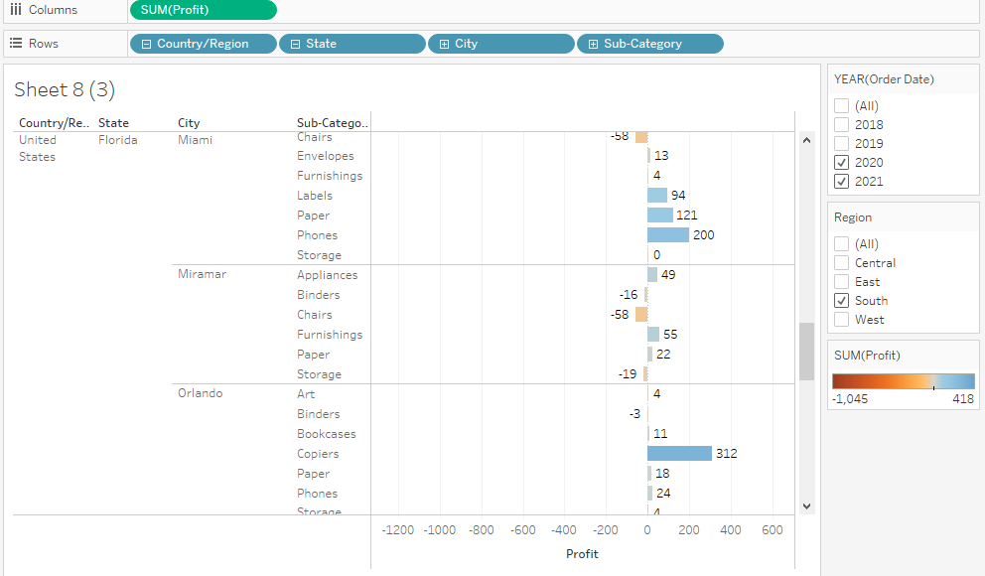
9.Check profit in 2020 and 2021

Slide 8
Find information how can we increase the profit
Remove unprofitable products and services
Find new customers
Reduce the expenses

